Slide 1


Lesson 24 Our holiday plans
UNIT 5

Slide 2

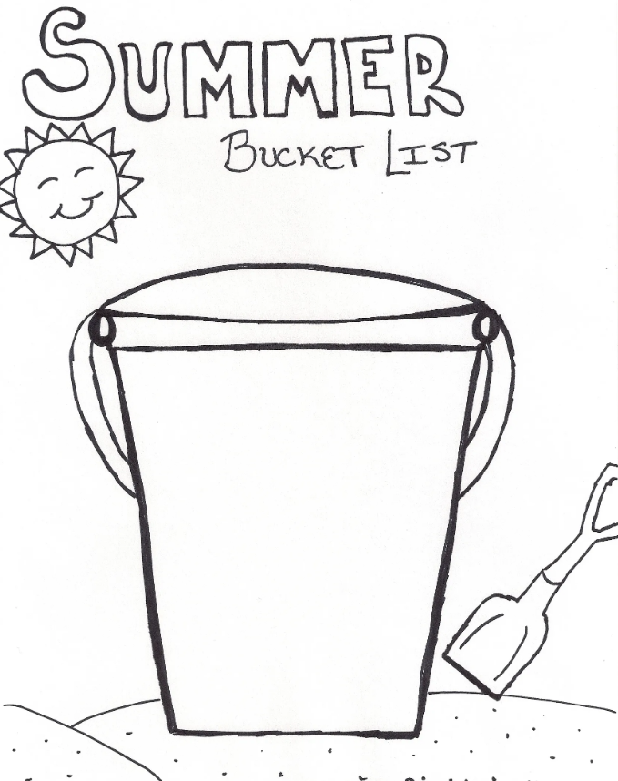
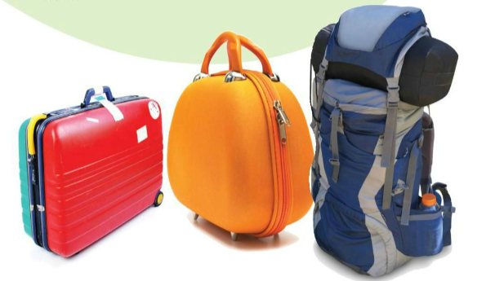
Write 10 things that you associate with summer.
Make your own SUMMER BUCKET LIST. Write 10 things you want to do or accomplish by the end of this summer.

Slide 3
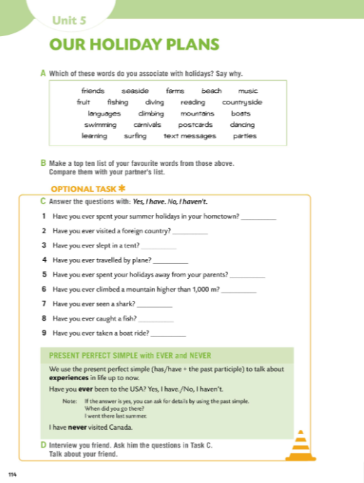

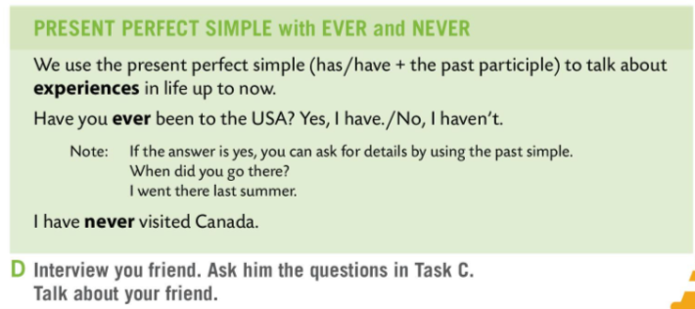
Workbook page 114.
LANGUAGE IN FOCUS
We use the present perfect simple (has/have + past participle) to talk about experiences in life up to now.
Glagolsko vrijeme present perfect simple (has/have + past participle) koristimo kada govorimo o dosadašnjim životnim iskustvima do trenutka u kojemu govorimo.
Have you ever been to the USA?
Yes, I have. / No, I haven’t.
I have never been to Canada.

Slide 4
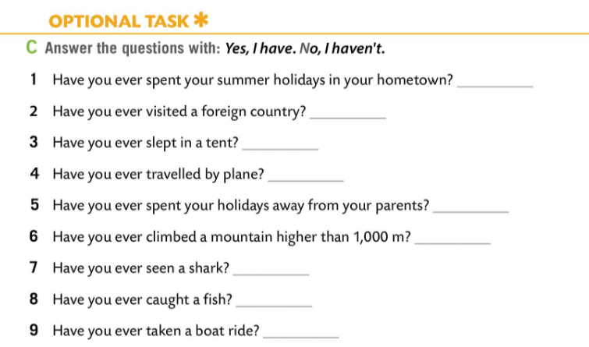
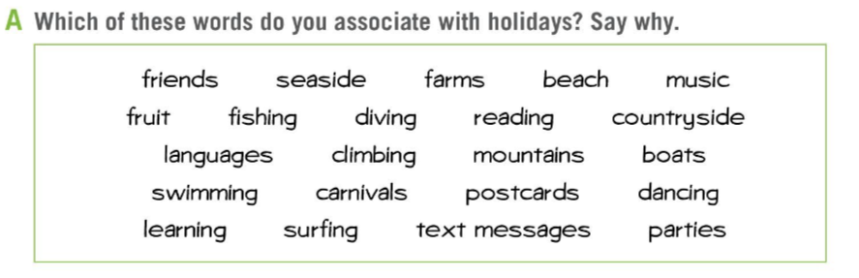
Workbook page 114.
Which words in Task A do you associate with holidays? Say why.
Answer the questions in Task C with: Yes, I have. or No, I haven’t.

Slide 5
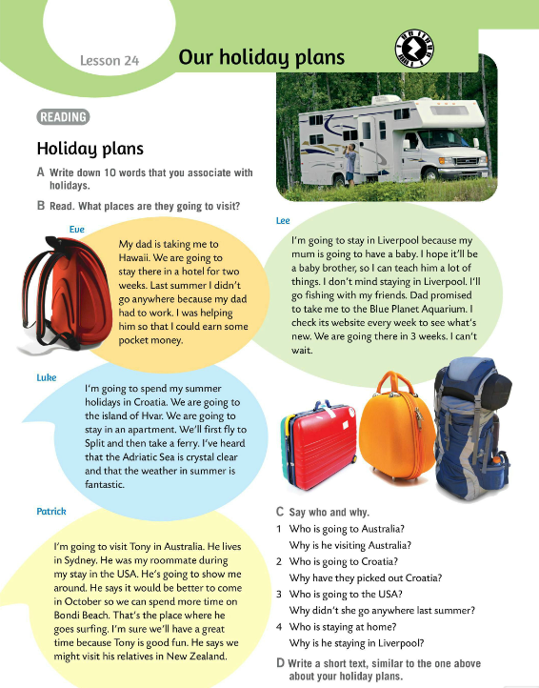
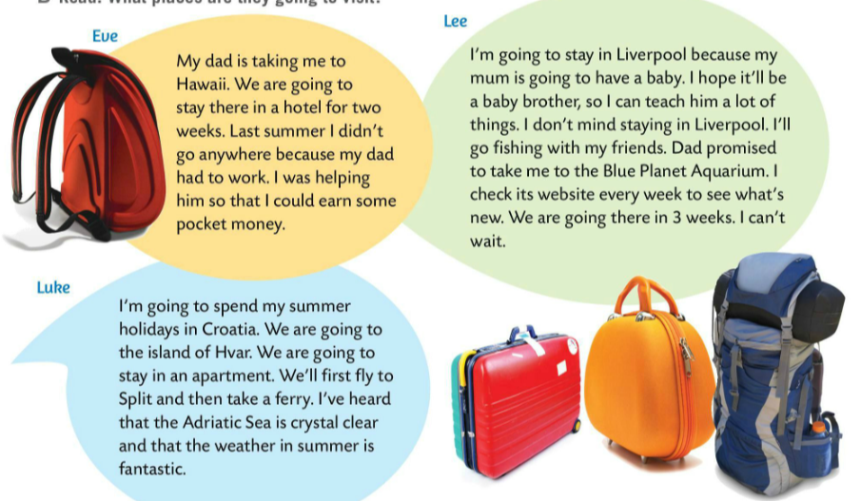
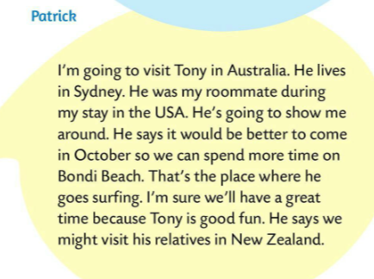
Read the texts in Task B.
What places are the children going to visit?
Eve is going to visit Hawaii, Lee is going to stay in Liverpool, Luke is going to Hvar and Split and Patrick is going to visit Australia and New Zealand.

Slide 6
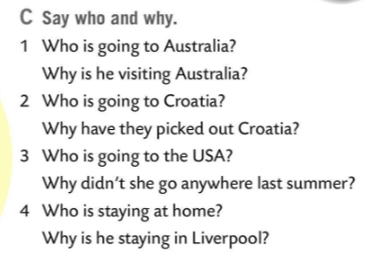
Read the texts once again and work in pairs. Answer the questions in Task C.
Check.
1 Patrick is going to Australia.
He is going to visit his former roomate.
2 Luke is going to Croatia.
They picked Croatia because of the clear Adriatic Sea and fantastic weather.
3 Eve is going to the USA.
She didn’t go anywhere last summer because her dad had to work.
4 Lee is staying in Liverpool.
He is staying at home because his mum is going to have a baby.
Write a short text, similar to the ones above, about your holiday plans.

Slide 7
Workbook page 114.
Interview your friend.
Ask him/her the questions in Task C. Talk about your friend.
Play the vocabulary game and fill in the sentences.
https://wordwall.net/play/511/249/975

